Slide 1
AI Agents
Liad Magen

Slide 2

Agenda
Designing Agentic Architectures
Advanced Agentic RAG Techniques
Complex retrieval and dynamic generation methods
Hands-on project: Building a robust Agentic RAG system

Slide 3





Agenda

Slide 4
Final Project!

Slide 5
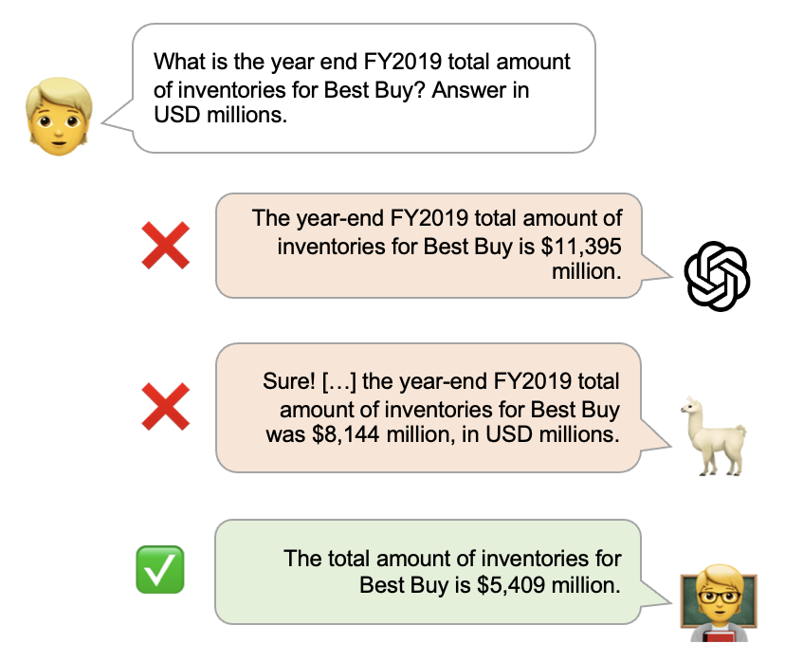
FinanceBench
SoTA - ~90%
patronus-ai/financebench

Slide 6
Dataset & Questions
What drove operating margin change as of FY2022 for 3M? If operating margin is not a useful metric for a company like this, then please state that and explain why.
Does AMD have a reasonably healthy liquidity profile based on its quick ratio for FY22? If the quick ratio is not relevant to measure liquidity, please state that and explain why.
Liadmagen/financebench_QA · Datasets at Hugging Face
Liadmagen/financebench_content · Datasets at Hugging Face

Slide 7
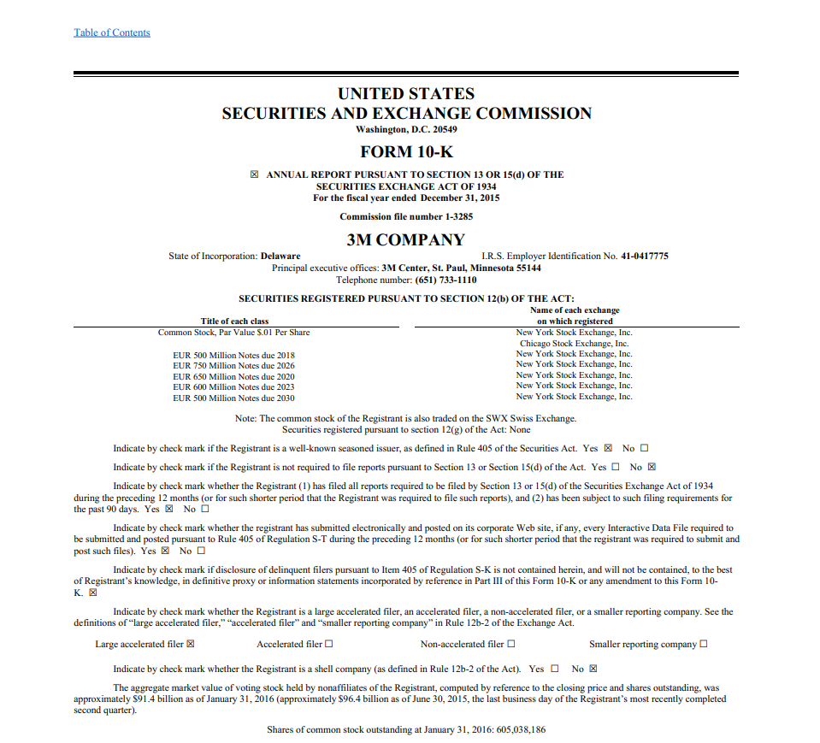
SEC Filing
Can be more than 150 pages long!

Slide 8
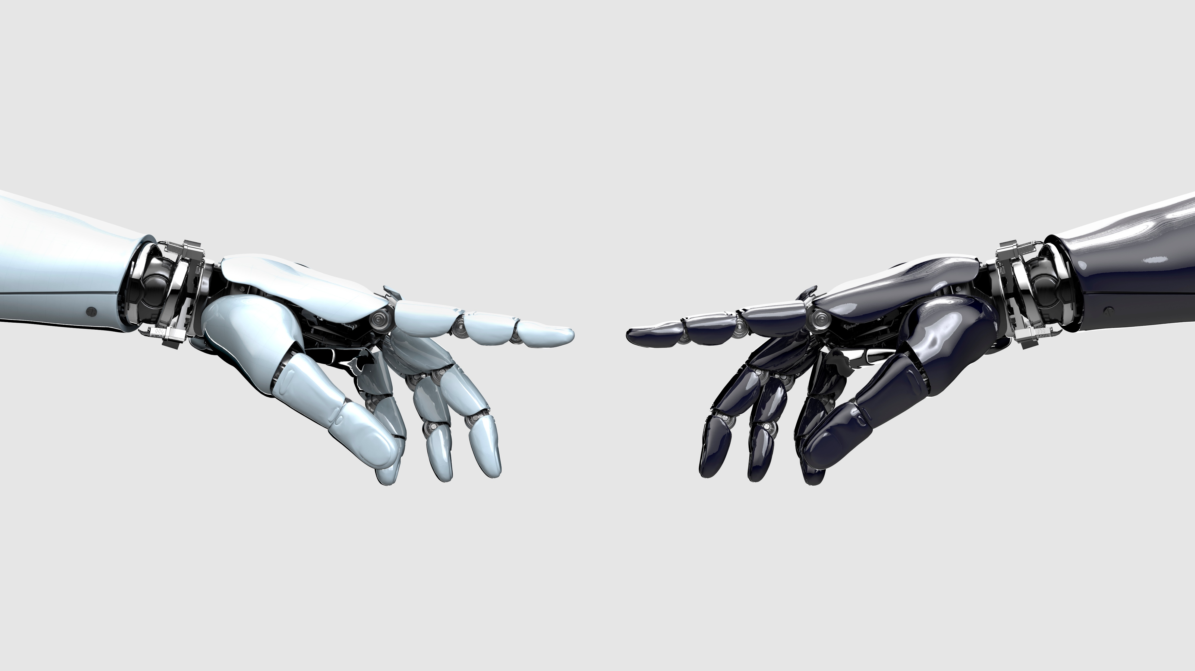
How well can your Agentic-IR score?
Good Luck!

Slide 9

Advanced Retrieval
Beyond Vector Similarity

Slide 10
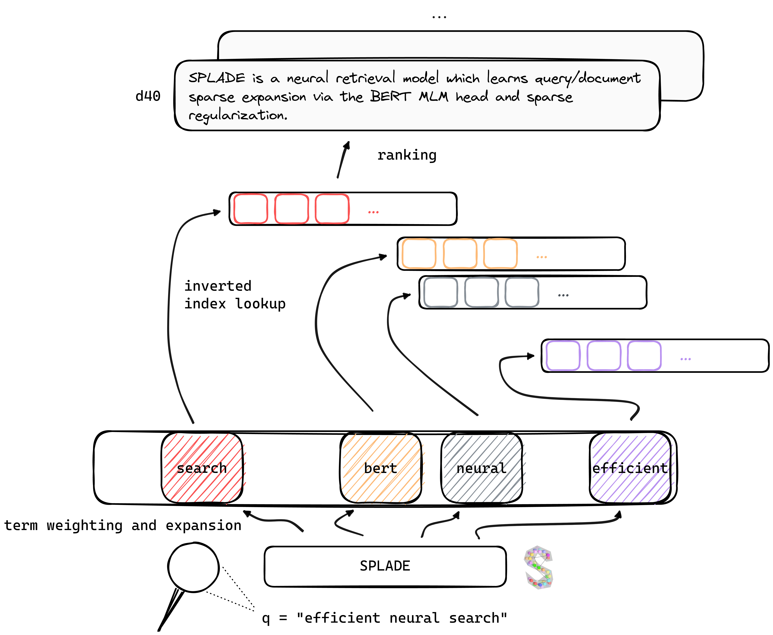
SPLADE
naver/splade: SPLADE: sparse neural search (SIGIR21, SIGIR22)

Slide 11
Hypothetical Document Embeddings (HyDE)
User enters a query
Model generates a hypothetic documents that answers is
Document is embedded
Vector Database
Matching Documents Returned
HyDE for RAG Explained: How Hypothetical Document Embeddings Boost Retrieval Accuracy

Slide 12
Not changing the Lookup (this time…)
Improve Filter ➔ Higher Precision
Improve Input ➔ Higher Recall
Candidates 📚
Filter ✂️
Results
🏁
Lookup 🔎
Query 🗨️
Vector Index Database

Slide 13
Improve Input
Extract content:
What was the revenue of that GPU producing company in the final quarter of 2024?

Slide 14

Improve Input
Extract content:
What was the revenue of that GPU producing company in the final quarter of 2024?
{
content: [
“…”,
“…”
]
}

Slide 15
Query 🗨️
Analyze 🤖
Candidates 📚
Filter ✂️
Results
🏁
Content
Lookup 🔎
Vector Index Database

Slide 16
Improve Input
Enhance the content:
What was the revenue of that GPU producing company in the final quarter of 2024?
Nvidia
AMD
Intel
TSMC ASUS
MSI

Slide 17
Query 🗨️
Question
Analyze 🤖
Candidates 📚
Content
Web Search
Search Terms
Lookup 🔎
Vector Index Database
HyDE
LLM Knowledge
Filter ✂️
Answers
Results
🏁

Slide 18
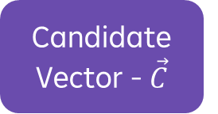
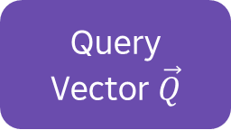
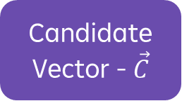
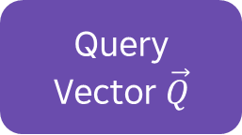
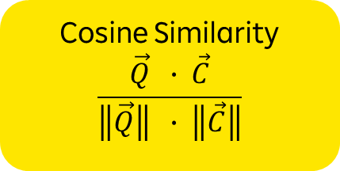
Improve Filter
Similarity
Rerank
Query
Vector $\vec{Q}$
Candidate Vector - $\vec{C}$
Query
Vector $\vec{Q}$
Candidate Vector - $\vec{C}$
Cosine Similarity
$$\frac{\vec{Q} ∙ \vec{C}}{\left\|\vec{Q}\right\| ∙ \left\|\vec{C}\right\|}$$
Reranker Transformer
➔ Score

Slide 19
Query 🗨️
Question
Vector Index Database
Answers
Analyze 🤖
Candidates 📚
Content
HyDE
Search Terms
Lookup 🔎
Rerank
Candidates + Ranking
Results
🏁
Filter ✂️

Slide 20
Improve the Filter
Find which companies improved their revenues by 10% or more, but not those who went down in the previous years
Read the user query and extract:
Search Content
Criteria for relevance
{
content: [“…”, “…”],
criteria: [“…”, “…”],
}

Slide 21
Improve the Filter
Candidates + Ranking
Results
🏁
Filter ✂️
Does the candidate company improved the revenue by 10% AND did not show decrease in the earning in the previous years?

Slide 22
Query 🗨️
Question
Vector Index Database
Answers
Analyze 🤖
Candidates 📚
Content
HyDE
Search Terms
Lookup 🔎
Generate 🤖
Criteria
Judge 🤖
Candidates + Ranking
Rerank
Candidates + Ranking
+ Relevance
Filter ✂️
Results
🏁

Slide 23
Queries with Metadata
What was the revenue of that GPU producing company in the final quarter of 2024?
{
content: [“…”, “…”],
criteria: [“…”, “…”],
metadata: [{…}, {…}]
}

Slide 24
Queries with Metadata
Given {metadata constraints}, and {DB Scheme} generate SQL query:
SELECT r.*, c.*
FROM company c
JOIN revenue r
ON c.c_id = r.c_id
WHERE r.year <= 2024

Slide 25
Query 🗨️
Tabular DB
Vector Index DB
Analyze 🤖
Metadata
text2sql
constraints
Candidates 📚
Content
HyDE
Search Terms
Lookup 🔎
Generate 🤖
Criteria
Judge 🤖
Candidates + Ranking
Rerank
Candidates + Ranking
+ Relevance
Filter ✂️
Results
🏁

Slide 26
Improve Your Retrieval Systems!
Only Extract the relevant content from the query
Rewrite the content to match the search domain documents
Rerank the content matching
Extract relevance criteria with LLMs
Connect the retrieval to tabular metadata
And don’t forget to evaluate your system!
Precision@k / Recall@k
MAP
MRR
NCDG

Slide 27
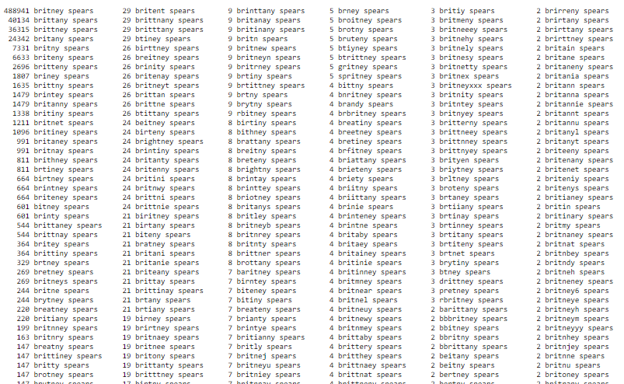
Notes:
some of the misspellings detected by our spelling correction system for the query [ Britney spears ], and the count of how many different users spelled her name that way

Slide 28
Agentic Architecture
Advanced Agentic AI

Slide 29
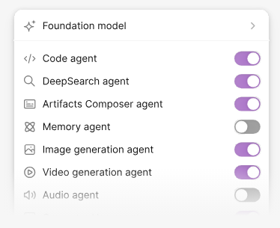
Better Focus!
Agents should be limited to a single task.
Open Agent

Slide 30
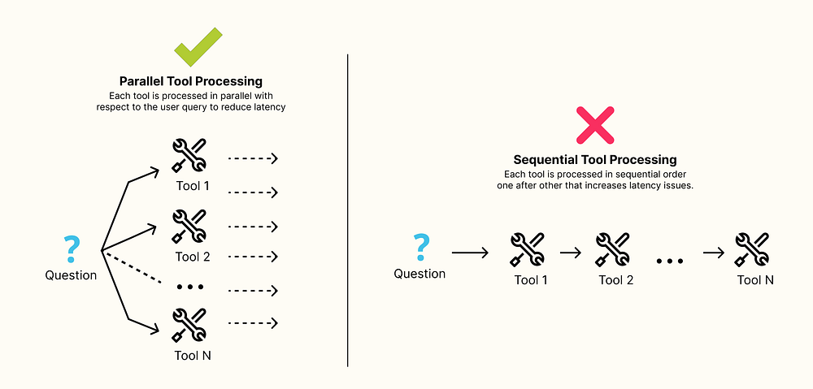
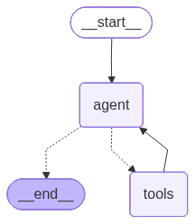
Parallel Tool Use

Slide 31
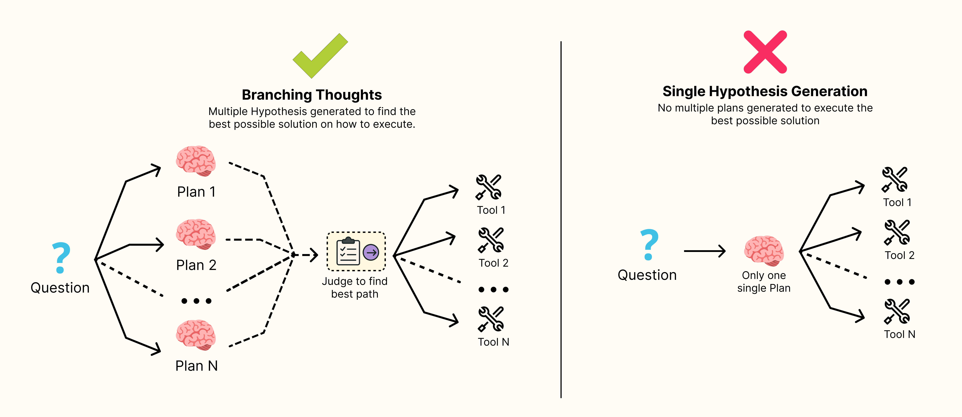
Hypothesis Generation to Strategic Exploration

Slide 32
Parallel Evaluation

Slide 33
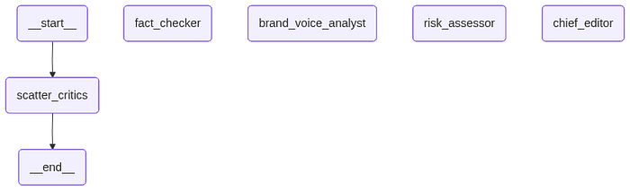
Parallel Evaluation

Slide 34
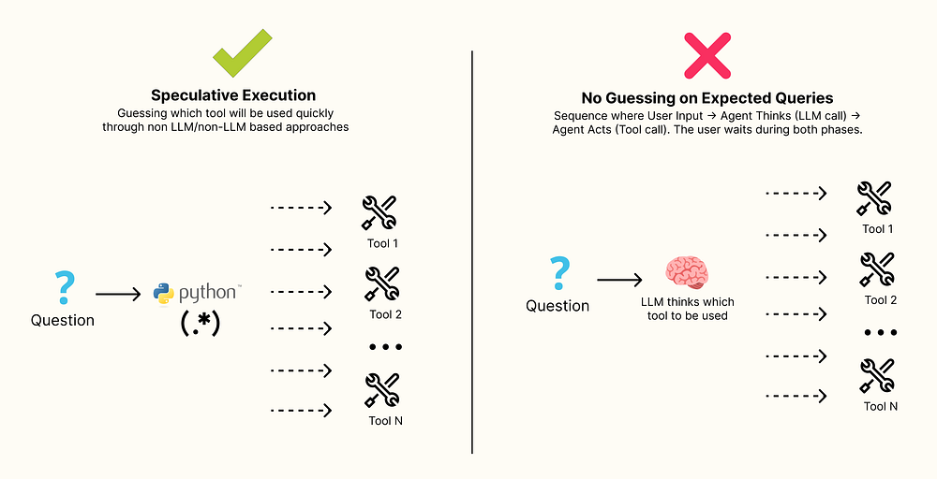
Don’t let LLM do all the work!

Slide 35
Using Multiple Agents

Slide 36
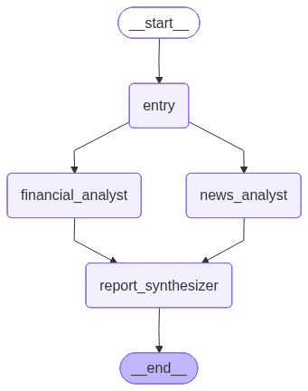
Using Multiple Agents

Slide 37
Competitive Agent Ensembles

Slide 38
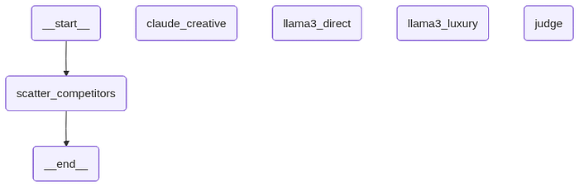
Competitive Agent Ensembles

Slide 39
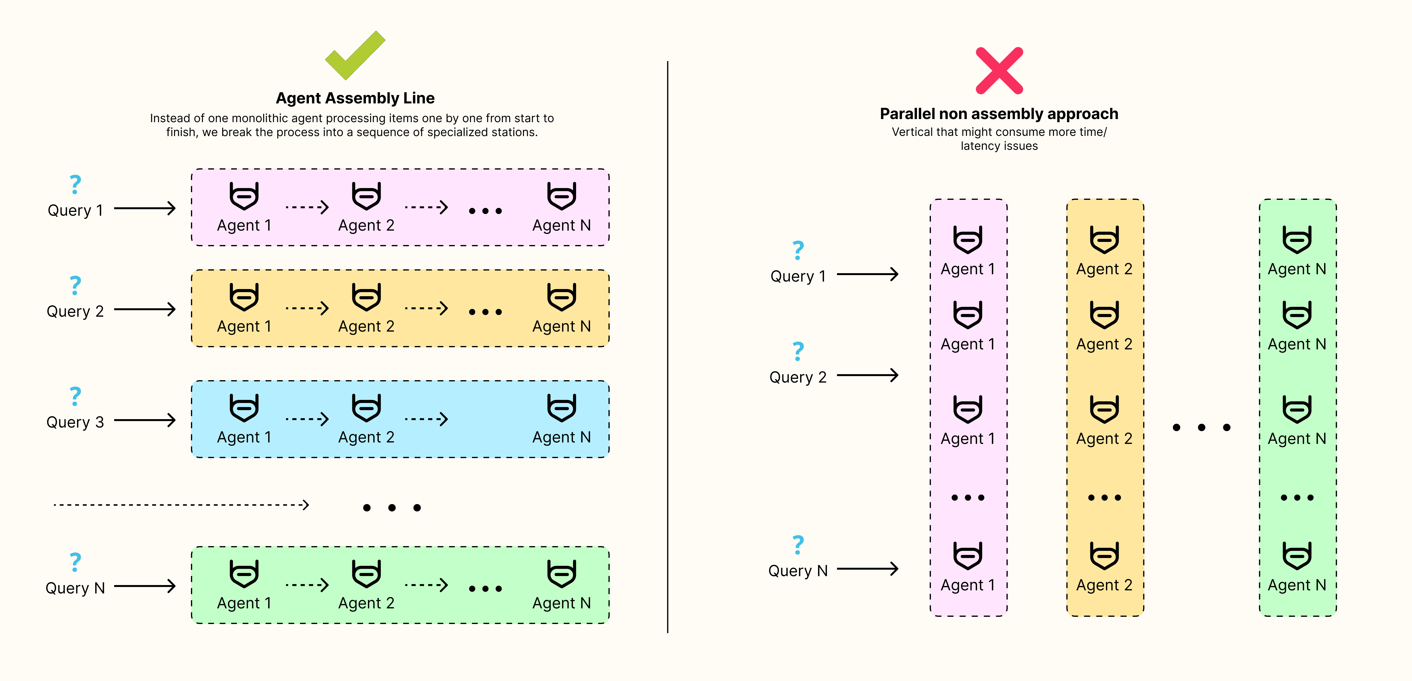
Using Specialized Agents

Slide 40
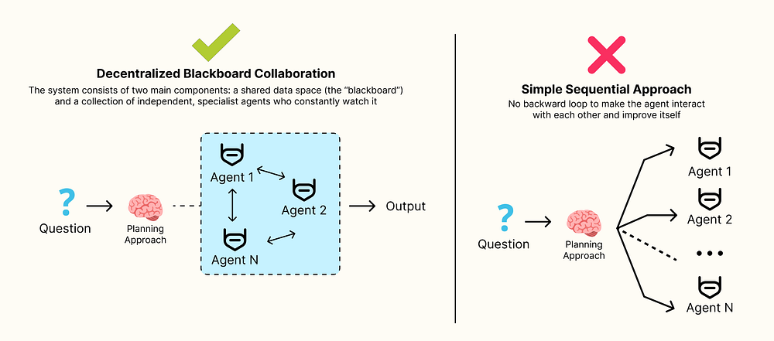
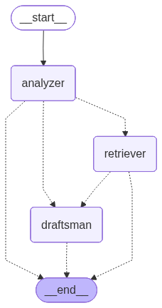
For Complex Analysis Tasks

Slide 41
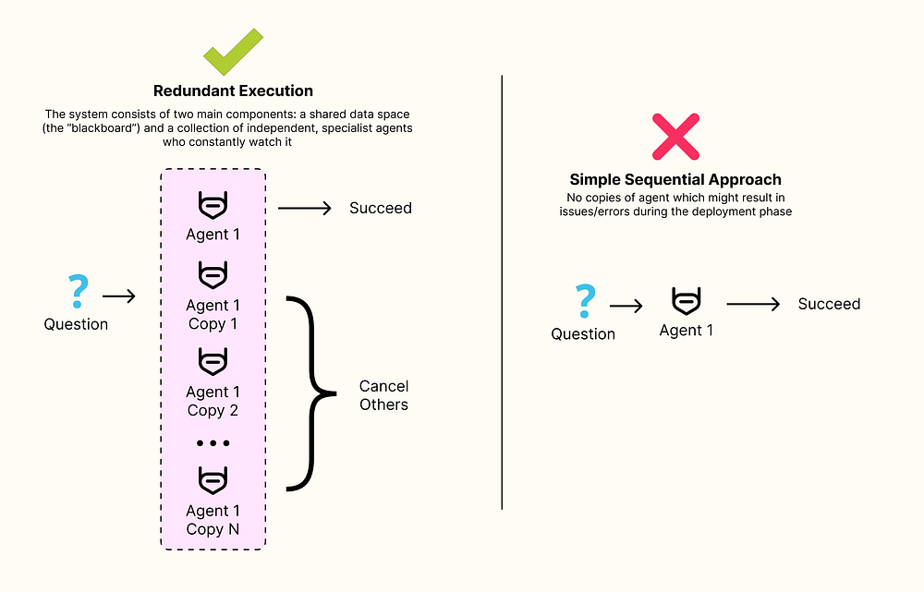
Fault Tolerance in Deployment

Slide 42
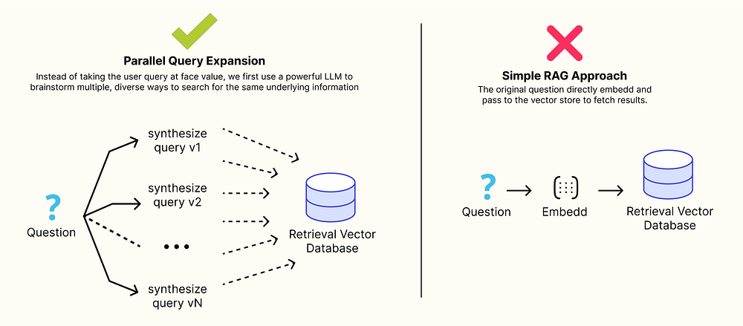
Parallel Query Expansion to Maximize Recall

Slide 43
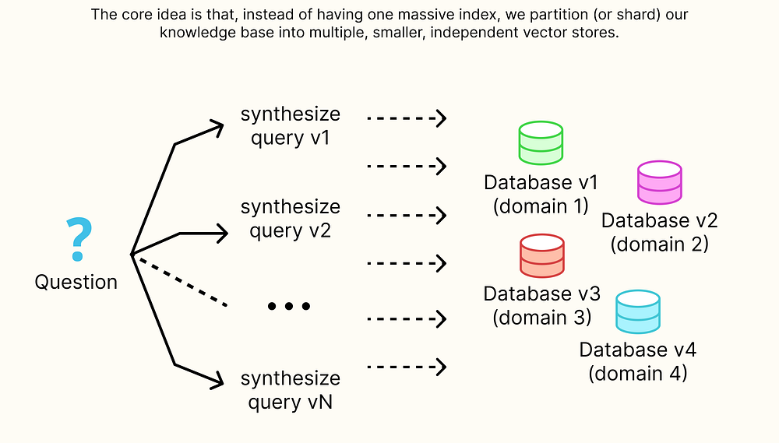
Sharded & Scattered Retrieval

Slide 44
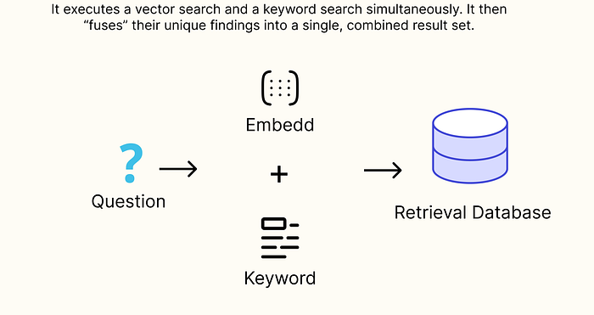
Parallel Hybrid Search Fusion

Slide 45
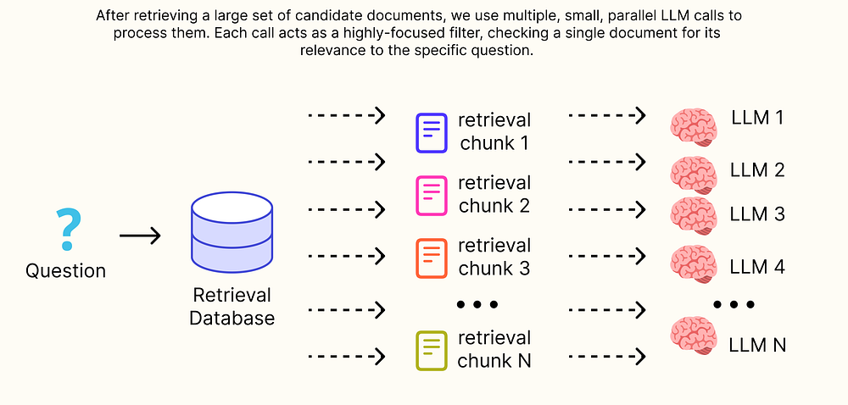
Parallel Context Pre-processing

Slide 46
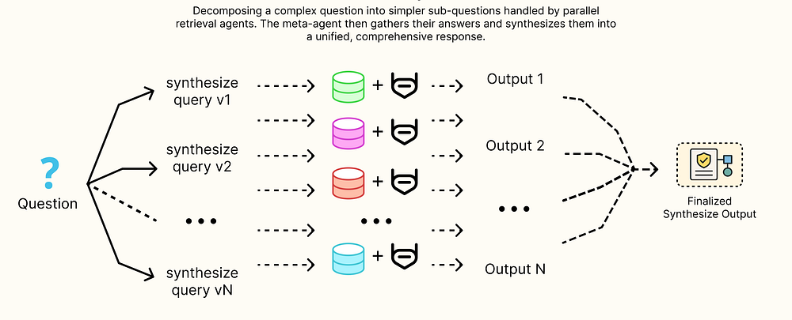
Parallel Multi-Hop Retrieval

Slide 47

Asta

Slide 48
Resources
Building the 14 Key Pillars of Agentic AI | by Fareed Khan | Nov, 2025 | Level Up Coding
Ai2 Asta
Open Agent

